Slide 1

EUCAST
The Development and Use of ECOFFs and the EUCAST International MIC distribution Database
Gunnar Kahlmeter, Professor, FESCMID
EUCAST SC Technical Data Coordinator
Chair of Subcommittee on MIC distributions and the setting of epidemiological cut-off (ECOFF) values.

Slide 2
The MIC wild type distribution and ECOFF
In 2002, EUCAST launched the concept of gathering many MIC distributions from many and different sources, to aggregate and present on a web site as reference MIC distributions for each species/agent combination.
Epidemiological cut-off values (ECOFF) were determined by visual inspection on the reference distributions and ECOFFs and MIC distributions used as one of several tools in the process of harmonising European clinical breakpoints.
The MIC distributions and ECOFFs have been publicly available for the last 15 years.

Slide 3


Slide 4
MIC distributions and ECOFFs on EUCAST website
>0.5 million hits per year
>32 000 MIC distributions
Up to 100 000 MIC-values per distribution
Data from many investigators (1 – 100 per distrib.)
Data from many time periods (1950 - )
Data from many geographical areas and projects
(USA, Europe, Australia, Far East, South America, Sentry, Mystic, etc)
Data of multiple origin
(Human clinical data, Surveillance programs, Veterinarian data, Wild life, Food safety programs)
Ownership:
  Software and administration: ESCMID/EUCAST
  Database: individual ownership of original data

Slide 5
MIC distributions in the EUCAST database originates from…
breakpoint committee material
individual researchers in human and veterinary medicine
programmes for the surveillance of antimicrobial resistance in humans and animals
EUCAST development projects
pharmaceutical companies as part of programmes for the development of new agents
…and more.

Slide 6
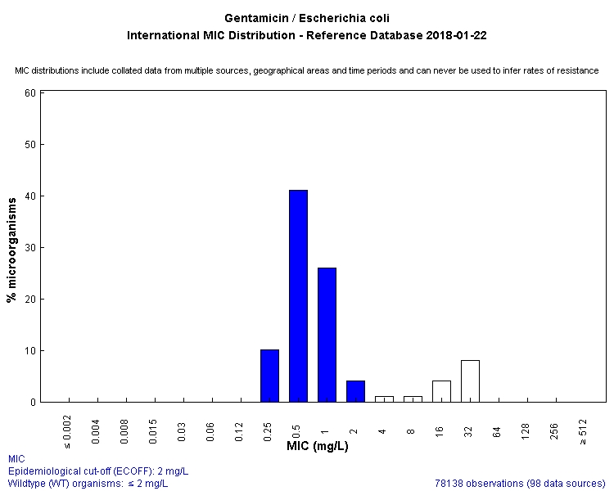
EUCAST MIC distributions programme
Agent | Species | No of distributions | Isolates (MICs)
Benzylpenicillin | Strc. pneumoniae | 33 | 37 742
Benzylpenicillin | Strc. pyogenes | 12 | 3 648
Cefotaxime | E. coli | 41 | 10 397
Cefotaxime | Strc. pneumoniae | 25 | 12 900
Cefotaxime | H. influenzae | 23 | 13 685
Cefuroxime | E. coli | 34 | 96 013
Erythromycin | H. influenzae | 15 | 29 226
Colistin | E. coli | 14 | 6 064
Colistin | Ps. aeruginosa | 23 | 13 176
Meropenem | K. pneumoniae | 67 | 18 171
Gentamicin | E. coli | 98 | 78 138
All | All species | 33 449 | ?

Slide 7
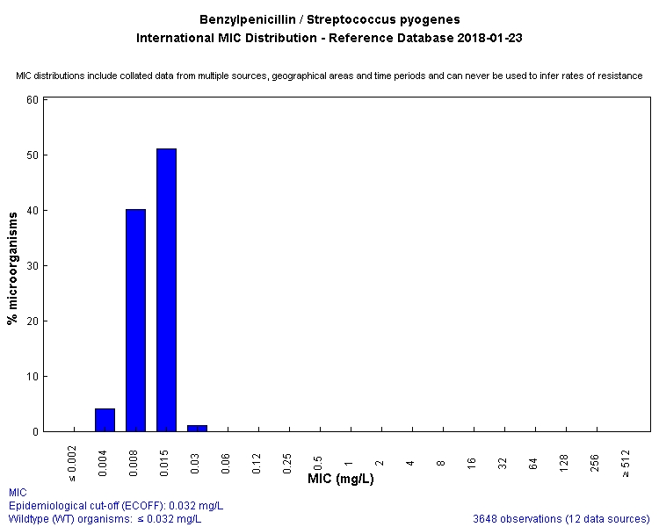

Slide 8
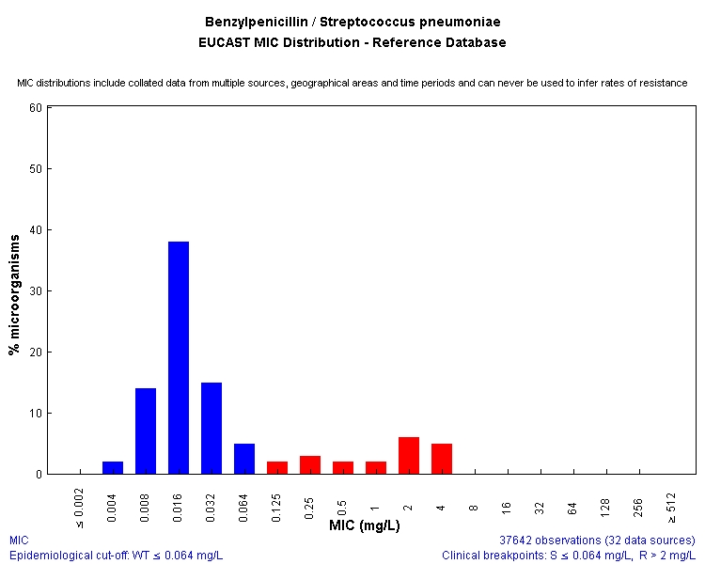

Slide 9
The use of ECOFFs
As a tool in the determination of clinical breakpoints
  To avoid dividing wild type MIC distributions of important target organisms
  As a surrogate clinical breakpoint when Pk/Pd data is incomplete and clinical data pertain only to wild type organisms
For sensitive detection of (screening for) resistance
  oxacillin to detect all penicillin-R in S. pneumoniae
  cefoxitin to detect methicillin resistance in S. aureus
  benzylpenicillin to detect all betalactam resistance in H.influenzae
  pefloxacin to detect quinolone resistance in Salmonella spp
  meropenem to screen for KPC in Enterobacteriaceae
For surveillance of antimicrobial resistance when clinical breakpoints…
  are not sensitive enough
  have not been determined
  change over time
  differ between systems (CLSI, FDA, EUCAST etc)
  differ between humans, cows, pigs, birds, fish and camels.
To exclude resistance

Slide 10
EUCAST Subcommittee on MIC distributions and the setting of ECOFFs
43 international colleagues
Human and veterinary medicine
Experts in phenotypic susceptibility testing, resistance mechanisms and WGS.
Two internal consultations.
One general (public) consultation.
EUCAST SOP 10 on MIC distributions and the setting of ECOFFs.

Slide 11
10
Available on www.eucast.org

Slide 12
The ECOFF is…
…determined on phenotypic traits only (but in several articles excellent correlation between ECOFF and WGS assessments have been demonstrated).
…for a given species and antimicrobial agent, the highest MIC for organisms devoid of phenotypically detectable acquired resistance mechanisms.
...the same irrespective of when, where and from which animals the organisms are obtained.
…defined by the agent without the inhibitor for agents which consist of an active drug and an inhibitor.
…the lowest possible S-breakpoint in a species deemed susceptible (S) to the agent.

Slide 13
Underlying assumptions
MIC measurement has inherent variability due to both intra- and inter- laboratory variation which can never be eliminated.
In a species, organisms without phenotypically expressed resistance, still exhibit some biological but the extent to which this is directly attributable to the antibiotic is not known.

Slide 14
M Sundquist, G Kahlmeter. Factors influencing mecillinam susceptibility.
Notes:
14

Slide 15
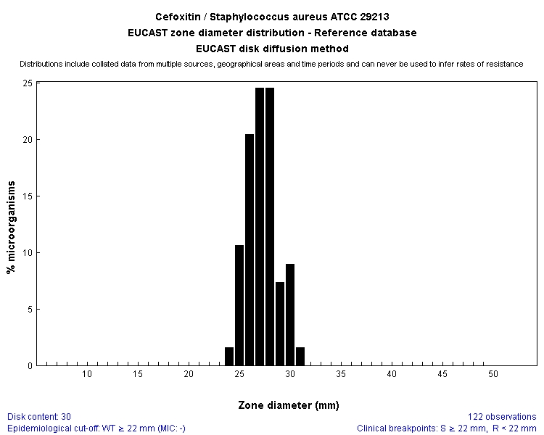
Random day-to-day variation over time when 10 lab technicians perform regular IQC on one and the same ATCC-strain.
Notes:
Example of analysis of inhibition zone histograms
ATCC 29213 /approximately 10 lab technicians

Slide 16
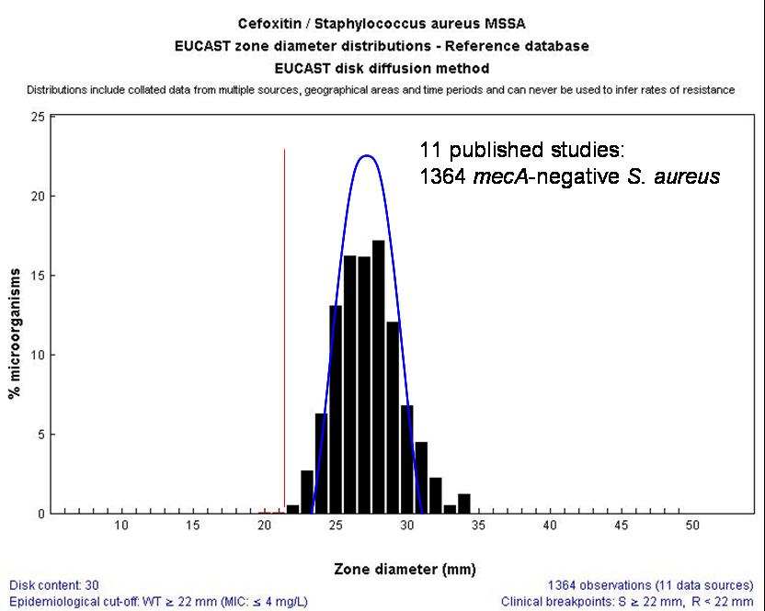
>11 lab technicians performing cefoxitin disk testing on 1364 clinical mecA-negative isolates of S. aureus.
The blue curve is transposed from the previous slide and shows the random day-to-day QC assay variation on one ATCC strain.
Notes:
16

Slide 17
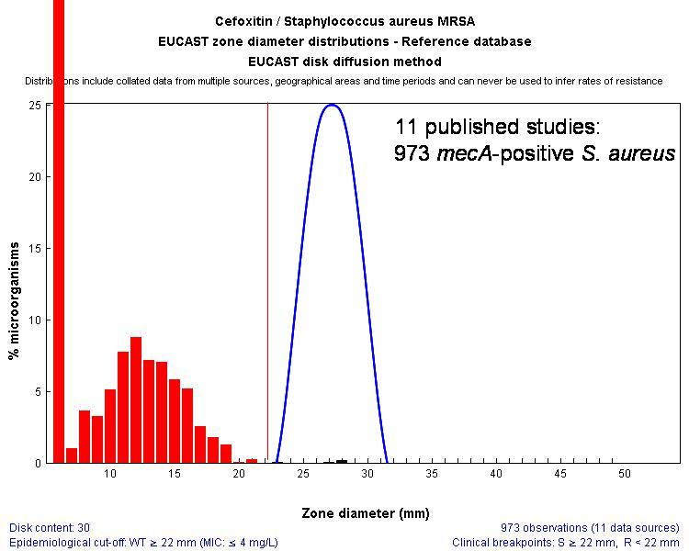
Notes:
17

Slide 18
Subcommittee rules for acceptance of MIC distributions.
The aggregated MIC distribution must include at least five valid MIC distributions, each generated in a separate laboratory. This is essential to ensure that interlaboratory variation is factored into the definition of the reference MIC distribution and for the setting of ECCOFFs.
The aggregated MIC distribution must contain at least 100 MIC values in the putative wild-type distribution. Individual distributions must contain at least 15 values.
The modes of the individual wild-type distributions in the dataset must be equal to or within one two-fold dilution of the most common mode observed in the collection of valid distributions prior to aggregation.
If a dominant distribution in the dataset contributes more than 50% of the MIC values, it may be necessary to acquire additional distributions prior to setting the ECOFF.
This will be the case if the mode of putative wild-type distribution after aggregation is different when the dominant distribution is excluded.

Slide 19
0,002 | 0,004 | 0,008 | 0,016 | 0,032 | 0,064 | 0,12 | 0,25 | 0,5 | 1 | 2 | 4 | 8 | 126 | 32 | 64 | 128 | 256
0 | 0 | 0 | 0 | 0 | 0 | 0 | 1671 | 205 | 20 | 6 | 2 | 0 | 0 | 1 | 17 | 0 | 0
0 | 0 | 0 | 0 | 0 | 4 | 16 | 10 | 4 | 0 | 6 | 1 | 2 | 3 | 0 | 0 | 0 | 0
0 | 0 | 3 | 1 | 28 | 51 | 9 | 3 | 3 | 0 | 1 | 1 | 0 | 0 | 0 | 0 | 0 | 0
0 | 4 | 7 | 47 | 310 | 510 | 99 | 12 | 5 | 4 | 1 | 0 | 0 | 1 | 0 | 0 | 0 | 0
0 | 0 | 1 | 20 | 97 | 185 | 116 | 31 | 33 | 6 | 5 | 3 | 7 | 1 | 42 | 23 | 7 | 0
0 | 0 | 0 | 0 | 28 | 108 | 88 | 13 | 3 | 3 | 0 | 1 | 0 | 0 | 0 | 0 | 0 | 1
0 | 1 | 8 | 60 | 105 | 58 | 19 | 5 | 8 | 5 | 0 | 0 | 0 | 0 | 0 | 0 | 0 | 0
0 | 0 | 0 | 0 | 0 | 135 | 37 | 12 | 5 | 5 | 3 | 8 | 3 | 11 | 8 | 14 | 32 | 116
0 | 0 | 0 | 0 | 0 | 28 | 41 | 7 | 1 | 1 | 0 | 0 | 0 | 0 | 0 | 0 | 0 | 0
0 | 0 | 0 | 0 | 8 | 149 | 113 | 25 | 2 | 0 | 1 | 3 | 1 | 1 | 0 | 0 | 0 | 0
0 | 0 | 0 | 0 | 24 | 181 | 102 | 9 | 0 | 0 | 0 | 2 | 0 | 0 | 0 | 0 | 0 | 0
0 | 0 | 0 | 0 | 0 | 0 | 301 | 12 | 0 | 1 | 1 | 0 | 1 | 2 | 0 | 0 | 0 | 0
0 | 0 | 0 | 0 | 0 | 0 | 150 | 2 | 1 | 1 | 2 | 2 | 2 | 4 | 0 | 0 | 0 | 0
0 | 0 | 0 | 0 | 0 | 0 | 159 | 1 | 0 | 1 | 2 | 0 | 1 | 1 | 0 | 0 | 0 | 0
0 | 0 | 0 | 0 | 0 | 0 | 263 | 8 | 0 | 0 | 6 | 3 | 4 | 3 | 13 | 0 | 0 | 0
0 | 0 | 0 | 0 | 15 | 188 | 90 | 7 | 2 | 0 | 0 | 0 | 0 | 0 | 0 | 0 | 0 | 0
0 | 0 | 0 | 1 | 29 | 206 | 73 | 7 | 1 | 0 | 0 | 0 | 0 | 1 | 0 | 0 | 0 | 0
0 | 0 | 0 | 0 | 0 | 0 | 313 | 4 | 0 | 0 | 0 | 1 | 0 | 0 | 0 | 0 | 0 | 0
0 | 0 | 0 | 0 | 0 | 0 | 294 | 5 | 2 | 2 | 2 | 2 | 2 | 4 | 0 | 0 | 0 | 0
0 | 0 | 0 | 0 | 0 | 0 | 311 | 3 | 0 | 1 | 3 | 0 | 1 | 1 | 0 | 0 | 0 | 0
0 | 0 | 0 | 0 | 0 | 0 | 292 | 2 | 1 | 0 | 1 | 0 | 0 | 0 | 0 | 0 | 0 | 0
0 | 0 | 0 | 0 | 49 | 82 | 85 | 12 | 4 | 2 | 0 | 2 | 1 | 5 | 0 | 0 | 1 | 0
0 | 0 | 0 | 0 | 0 | 0 | 593 | 23 | 4 | 8 | 5 | 6 | 2 | 2 | 1 | 0 | 0 | 0
0 | 0 | 1 | 4 | 39 | 135 | 38 | 4 | 4 | 1 | 2 | 0 | 3 | 6 | 3 | 1 | 0 | 3
0 | 0 | 0 | 17 | 97 | 558 | 251 | 42 | 11 | 6 | 0 | 1 | 0 | 0 | 0 | 0 | 0 | 2
0 | 0 | 0 | 19 | 86 | 408 | 390 | 49 | 12 | 3 | 0 | 2 | 1 | 0 | 1 | 0 | 0 | 2
0 | 0 | 3 | 42 | 200 | 514 | 49 | 14 | 1 | 4 | 0 | 0 | 1 | 0 | 1 | 0 | 0 | 0
0 | 0 | 2 | 1 | 11 | 57 | 25 | 17 | 4 | 6 | 1 | 4 | 1 | 2 | 1 | 1 | 0 | 0
0 | 0 | 1 | 1 | 14 | 41 | 36 | 9 | 2 | 2 | 5 | 1 | 0 | 1 | 0 | 3 | 0 | 1
0 | 0 | 1 | 3 | 27 | 48 | 22 | 4 | 4 | 2 | 1 | 1 | 0 | 0 | 1 | 0 | 0 | 0
0 | 0 | 0 | 0 | 1 | 2 | 5 | 0 | 0 | 0 | 0 | 0 | 0 | 0 | 0 | 0 | 0 | 0
0 | 0 | 0 | 0 | 3 | 7 | 2 | 0 | 2 | 0 | 1 | 0 | 1 | 1 | 0 | 0 | 1 | 0
0 | 0 | 0 | 2 | 10 | 13 | 1 | 0 | 3 | 1 | 2 | 0 | 0 | 0 | 0 | 0 | 0 | 1
0 | 0 | 1 | 0 | 1 | 25 | 81 | 8 | 5 | 2 | 0 | 2 | 1 | 0 | 1 | 1 | 0 | 5
0 | 0 | 0 | 2 | 19 | 19 | 60 | 20 | 5 | 4 | 3 | 1 | 1 | 3 | 1 | 0 | 1 | 7
0 | 0 | 0 | 0 | 0 | 0 | 1 | 0 | 0 | 0 | 0 | 0 | 0 | 0 | 0 | 0 | 0 | 0
0 | 0 | 0 | 1 | 0 | 5 | 2 | 0 | 0 | 1 | 0 | 0 | 0 | 0 | 0 | 0 | 1 | 0
0 | 0 | 4 | 3 | 18 | 20 | 4 | 5 | 6 | 1 | 0 | 1 | 0 | 1 | 0 | 0 | 0 | 0
0 | 0 | 0 | 2 | 9 | 10 | 8 | 2 | 3 | 4 | 1 | 0 | 1 | 0 | 0 | 1 | 0 | 0
0 | 0 | 1 | 0 | 18 | 24 | 10 | 3 | 6 | 1 | 0 | 0 | 0 | 0 | 0 | 1 | 0 | 0
0 | 0 | 0 | 1 | 2 | 17 | 5 | 1 | 0 | 1 | 0 | 0 | 1 | 0 | 0 | 0 | 0 | 0
0 | 0 | 0 | 0 | 8 | 19 | 9 | 4 | 2 | 1 | 1 | 0 | 0 | 0 | 0 | 0 | 0 | 0
0 | 0 | 0 | 0 | 13 | 13 | 10 | 6 | 1 | 1 | 1 | 0 | 0 | 0 | 0 | 1 | 0 | 0
0 | 0 | 0 | 1 | 7 | 18 | 17 | 2 | 1 | 0 | 0 | 0 | 0 | 0 | 0 | 0 | 1 | 0
0 | 0 | 1 | 0 | 7 | 16 | 9 | 8 | 1 | 0 | 0 | 1 | 0 | 1 | 0 | 1 | 0 | 1
0 | 0 | 0 | 0 | 12 | 11 | 2 | 7 | 0 | 1 | 1 | 1 | 0 | 0 | 0 | 0 | 0 | 0
0 | 0 | 0 | 0 | 4 | 20 | 9 | 6 | 1 | 0 | 1 | 0 | 0 | 0 | 0 | 0 | 1 | 1
0 | 0 | 0 | 0 | 0 | 3 | 9 | 2 | 1 | 0 | 0 | 0 | 0 | 0 | 0 | 1 | 2 | 0
0 | 0 | 0 | 0 | 4 | 5 | 1 | 1 | 0 | 1 | 0 | 11 | 0 | 0 | 0 | 0 | 0 | 0
0 | 0 | 0 | 0 | 0 | 1 | 0 | 0 | 0 | 17 | 0 | 5 | 0 | 0 | 0 | 0 | 0 | 0
0 | 0 | 0 | 2 | 28 | 8 | 4 | 6 | 0 | 0 | 1 | 0 | 0 | 0 | 0 | 0 | 0 | 0
0 | 0 | 0 | 2 | 0 | 0 | 0 | 0 | 0 | 0 | 0 | 0 | 0 | 0 | 0 | 0 | 0 | 0
0 | 0 | 0 | 0 | 1 | 1 | 0 | 0 | 0 | 0 | 0 | 0 | 0 | 1 | 0 | 0 | 0 | 0
0 | 0 | 0 | 1 | 0 | 2 | 0 | 1 | 0 | 0 | 0 | 0 | 0 | 0 | 0 | 0 | 0 | 0
0 | 0 | 0 | 0 | 4 | 16 | 3 | 0 | 0 | 0 | 0 | 0 | 0 | 1 | 0 | 0 | 0 | 0
0 | 0 | 0 | 0 | 7 | 20 | 4 | 2 | 0 | 0 | 0 | 1 | 0 | 0 | 0 | 0 | 0 | 0
0 | 0 | 0 | 17 | 0 | 48 | 29 | 6 | 2 | 0 | 0 | 0 | 0 | 1 | 2 | 0 | 0 | 0
0 | 0 | 0 | 17 | 0 | 61 | 22 | 3 | 0 | 0 | 0 | 0 | 0 | 0 | 0 | 0 | 0 | 1
0 | 0 | 1 | 0 | 4 | 52 | 24 | 9 | 1 | 0 | 1 | 0 | 0 | 0 | 0 | 1 | 0 | 1
0 | 0 | 2 | 0 | 12 | 43 | 16 | 4 | 1 | 1 | 1 | 0 | 1 | 0 | 0 | 0 | 1 | 2
0 | 0 | 0 | 2 | 4 | 2 | 0 | 2 | 2 | 1 | 0 | 0 | 0 | 0 | 1 | 0 | 0 | 0
0 | 0 | 0 | 1 | 4 | 12 | 0 | 8 | 0 | 0 | 0 | 0 | 0 | 1 | 1 | 0 | 0 | 0
0 | 0 | 0 | 0 | 2 | 4 | 0 | 0 | 0 | 0 | 0 | 0 | 0 | 0 | 0 | 0 | 0 | 0
0 | 0 | 0 | 5 | 0 | 13 | 5 | 1 | 0 | 0 | 0 | 0 | 1 | 0 | 0 | 0 | 1 | 0
0 | 0 | 0 | 7 | 0 | 14 | 7 | 0 | 3 | 0 | 1 | 0 | 1 | 3 | 0 | 2 | 0 | 2
0 | 0 | 0 | 0 | 0 | 1 | 0 | 0 | 0 | 0 | 0 | 0 | 0 | 0 | 0 | 0 | 0 | 0
0 | 0 | 0 | 0 | 2 | 0 | 1 | 0 | 1 | 0 | 0 | 0 | 0 | 0 | 0 | 0 | 0 | 0
0 | 0 | 3 | 5 | 62 | 113 | 25 | 8 | 3 | 1 | 0 | 3 | 3 | 5 | 1 | 0 | 1 | 3
0 | 0 | 0 | 3 | 18 | 105 | 71 | 12 | 4 | 0 | 1 | 0 | 1 | 7 | 4 | 0 | 8 | 3
0 | 0 | 0 | 26 | 205 | 816 | 302 | 76 | 39 | 17 | 14 | 5 | 11 | 10 | 12 | 97 | 0 | 0
0 | 0 | 0 | 0 | 0 | 0 | 0 | 0 | 0 | 0 | 1 | 0 | 2 | 0 | 23 | 0 | 0 | 0
0 | 0 | 0 | 0 | 0 | 0 | 0 | 0 | 58 | 1 | 2 | 0 | 0 | 0 | 0 | 0 | 0 | 0
Why some MIC distributions are not accepted?
This table consists of
72 MIC distributions for cefotaxime on E. coli.
41 were accepted.

Slide 20
0,002 | 0,004 | 0,008 | 0,016 | 0,032 | 0,064 | 0,12 | 0,25 | 0,5 | 1 | 2 | 4 | 8 | 126 | 32 | 64 | 128 | 256
0 | 0 | 0 | 0 | 0 | 0 | 0 | 1671 | 205 | 20 | 6 | 2 | 0 | 0 | 1 | 17 | 0 | 0
0 | 0 | 0 | 0 | 0 | 4 | 16 | 10 | 4 | 0 | 6 | 1 | 2 | 3 | 0 | 0 | 0 | 0
0 | 0 | 3 | 1 | 28 | 51 | 9 | 3 | 3 | 0 | 1 | 1 | 0 | 0 | 0 | 0 | 0 | 0
0 | 4 | 7 | 47 | 310 | 510 | 99 | 12 | 5 | 4 | 1 | 0 | 0 | 1 | 0 | 0 | 0 | 0
0 | 0 | 1 | 20 | 97 | 185 | 116 | 31 | 33 | 6 | 5 | 3 | 7 | 1 | 42 | 23 | 7 | 0
0 | 0 | 0 | 0 | 28 | 108 | 88 | 13 | 3 | 3 | 0 | 1 | 0 | 0 | 0 | 0 | 0 | 1
0 | 1 | 8 | 60 | 105 | 58 | 19 | 5 | 8 | 5 | 0 | 0 | 0 | 0 | 0 | 0 | 0 | 0
0 | 0 | 0 | 0 | 0 | 135 | 37 | 12 | 5 | 5 | 3 | 8 | 3 | 11 | 8 | 14 | 32 | 116
0 | 0 | 0 | 0 | 0 | 28 | 41 | 7 | 1 | 1 | 0 | 0 | 0 | 0 | 0 | 0 | 0 | 0
0 | 0 | 0 | 0 | 8 | 149 | 113 | 25 | 2 | 0 | 1 | 3 | 1 | 1 | 0 | 0 | 0 | 0
0 | 0 | 0 | 0 | 24 | 181 | 102 | 9 | 0 | 0 | 0 | 2 | 0 | 0 | 0 | 0 | 0 | 0
0 | 0 | 0 | 0 | 0 | 0 | 301 | 12 | 0 | 1 | 1 | 0 | 1 | 2 | 0 | 0 | 0 | 0
0 | 0 | 0 | 0 | 0 | 0 | 150 | 2 | 1 | 1 | 2 | 2 | 2 | 4 | 0 | 0 | 0 | 0
0 | 0 | 0 | 0 | 0 | 0 | 159 | 1 | 0 | 1 | 2 | 0 | 1 | 1 | 0 | 0 | 0 | 0
0 | 0 | 0 | 0 | 0 | 0 | 263 | 8 | 0 | 0 | 6 | 3 | 4 | 3 | 13 | 0 | 0 | 0
0 | 0 | 0 | 0 | 15 | 188 | 90 | 7 | 2 | 0 | 0 | 0 | 0 | 0 | 0 | 0 | 0 | 0
0 | 0 | 0 | 1 | 29 | 206 | 73 | 7 | 1 | 0 | 0 | 0 | 0 | 1 | 0 | 0 | 0 | 0
0 | 0 | 0 | 0 | 0 | 0 | 313 | 4 | 0 | 0 | 0 | 1 | 0 | 0 | 0 | 0 | 0 | 0
0 | 0 | 0 | 0 | 0 | 0 | 294 | 5 | 2 | 2 | 2 | 2 | 2 | 4 | 0 | 0 | 0 | 0
0 | 0 | 0 | 0 | 0 | 0 | 311 | 3 | 0 | 1 | 3 | 0 | 1 | 1 | 0 | 0 | 0 | 0
0 | 0 | 0 | 0 | 0 | 0 | 292 | 2 | 1 | 0 | 1 | 0 | 0 | 0 | 0 | 0 | 0 | 0
0 | 0 | 0 | 0 | 49 | 82 | 85 | 12 | 4 | 2 | 0 | 2 | 1 | 5 | 0 | 0 | 1 | 0
0 | 0 | 0 | 0 | 0 | 0 | 593 | 23 | 4 | 8 | 5 | 6 | 2 | 2 | 1 | 0 | 0 | 0
0 | 0 | 1 | 4 | 39 | 135 | 38 | 4 | 4 | 1 | 2 | 0 | 3 | 6 | 3 | 1 | 0 | 3
0 | 0 | 0 | 17 | 97 | 558 | 251 | 42 | 11 | 6 | 0 | 1 | 0 | 0 | 0 | 0 | 0 | 2
0 | 0 | 0 | 19 | 86 | 408 | 390 | 49 | 12 | 3 | 0 | 2 | 1 | 0 | 1 | 0 | 0 | 2
0 | 0 | 3 | 42 | 200 | 514 | 49 | 14 | 1 | 4 | 0 | 0 | 1 | 0 | 1 | 0 | 0 | 0
0 | 0 | 2 | 1 | 11 | 57 | 25 | 17 | 4 | 6 | 1 | 4 | 1 | 2 | 1 | 1 | 0 | 0
0 | 0 | 1 | 1 | 14 | 41 | 36 | 9 | 2 | 2 | 5 | 1 | 0 | 1 | 0 | 3 | 0 | 1
0 | 0 | 1 | 3 | 27 | 48 | 22 | 4 | 4 | 2 | 1 | 1 | 0 | 0 | 1 | 0 | 0 | 0
0 | 0 | 0 | 0 | 1 | 2 | 5 | 0 | 0 | 0 | 0 | 0 | 0 | 0 | 0 | 0 | 0 | 0
0 | 0 | 0 | 0 | 3 | 7 | 2 | 0 | 2 | 0 | 1 | 0 | 1 | 1 | 0 | 0 | 1 | 0
0 | 0 | 0 | 2 | 10 | 13 | 1 | 0 | 3 | 1 | 2 | 0 | 0 | 0 | 0 | 0 | 0 | 1
0 | 0 | 1 | 0 | 1 | 25 | 81 | 8 | 5 | 2 | 0 | 2 | 1 | 0 | 1 | 1 | 0 | 5
0 | 0 | 0 | 2 | 19 | 19 | 60 | 20 | 5 | 4 | 3 | 1 | 1 | 3 | 1 | 0 | 1 | 7
0 | 0 | 0 | 0 | 0 | 0 | 1 | 0 | 0 | 0 | 0 | 0 | 0 | 0 | 0 | 0 | 0 | 0
0 | 0 | 0 | 1 | 0 | 5 | 2 | 0 | 0 | 1 | 0 | 0 | 0 | 0 | 0 | 0 | 1 | 0
0 | 0 | 4 | 3 | 18 | 20 | 4 | 5 | 6 | 1 | 0 | 1 | 0 | 1 | 0 | 0 | 0 | 0
0 | 0 | 0 | 2 | 9 | 10 | 8 | 2 | 3 | 4 | 1 | 0 | 1 | 0 | 0 | 1 | 0 | 0
0 | 0 | 1 | 0 | 18 | 24 | 10 | 3 | 6 | 1 | 0 | 0 | 0 | 0 | 0 | 1 | 0 | 0
0 | 0 | 0 | 1 | 2 | 17 | 5 | 1 | 0 | 1 | 0 | 0 | 1 | 0 | 0 | 0 | 0 | 0
0 | 0 | 0 | 0 | 8 | 19 | 9 | 4 | 2 | 1 | 1 | 0 | 0 | 0 | 0 | 0 | 0 | 0
0 | 0 | 0 | 0 | 13 | 13 | 10 | 6 | 1 | 1 | 1 | 0 | 0 | 0 | 0 | 1 | 0 | 0
0 | 0 | 0 | 1 | 7 | 18 | 17 | 2 | 1 | 0 | 0 | 0 | 0 | 0 | 0 | 0 | 1 | 0
0 | 0 | 1 | 0 | 7 | 16 | 9 | 8 | 1 | 0 | 0 | 1 | 0 | 1 | 0 | 1 | 0 | 1
0 | 0 | 0 | 0 | 12 | 11 | 2 | 7 | 0 | 1 | 1 | 1 | 0 | 0 | 0 | 0 | 0 | 0
0 | 0 | 0 | 0 | 4 | 20 | 9 | 6 | 1 | 0 | 1 | 0 | 0 | 0 | 0 | 0 | 1 | 1
0 | 0 | 0 | 0 | 0 | 3 | 9 | 2 | 1 | 0 | 0 | 0 | 0 | 0 | 0 | 1 | 2 | 0
0 | 0 | 0 | 0 | 4 | 5 | 1 | 1 | 0 | 1 | 0 | 11 | 0 | 0 | 0 | 0 | 0 | 0
0 | 0 | 0 | 0 | 0 | 1 | 0 | 0 | 0 | 17 | 0 | 5 | 0 | 0 | 0 | 0 | 0 | 0
0 | 0 | 0 | 2 | 28 | 8 | 4 | 6 | 0 | 0 | 1 | 0 | 0 | 0 | 0 | 0 | 0 | 0
0 | 0 | 0 | 2 | 0 | 0 | 0 | 0 | 0 | 0 | 0 | 0 | 0 | 0 | 0 | 0 | 0 | 0
0 | 0 | 0 | 0 | 1 | 1 | 0 | 0 | 0 | 0 | 0 | 0 | 0 | 1 | 0 | 0 | 0 | 0
0 | 0 | 0 | 1 | 0 | 2 | 0 | 1 | 0 | 0 | 0 | 0 | 0 | 0 | 0 | 0 | 0 | 0
0 | 0 | 0 | 0 | 4 | 16 | 3 | 0 | 0 | 0 | 0 | 0 | 0 | 1 | 0 | 0 | 0 | 0
0 | 0 | 0 | 0 | 7 | 20 | 4 | 2 | 0 | 0 | 0 | 1 | 0 | 0 | 0 | 0 | 0 | 0
0 | 0 | 0 | 17 | 0 | 48 | 29 | 6 | 2 | 0 | 0 | 0 | 0 | 1 | 2 | 0 | 0 | 0
0 | 0 | 0 | 17 | 0 | 61 | 22 | 3 | 0 | 0 | 0 | 0 | 0 | 0 | 0 | 0 | 0 | 1
0 | 0 | 1 | 0 | 4 | 52 | 24 | 9 | 1 | 0 | 1 | 0 | 0 | 0 | 0 | 1 | 0 | 1
0 | 0 | 2 | 0 | 12 | 43 | 16 | 4 | 1 | 1 | 1 | 0 | 1 | 0 | 0 | 0 | 1 | 2
0 | 0 | 0 | 2 | 4 | 2 | 0 | 2 | 2 | 1 | 0 | 0 | 0 | 0 | 1 | 0 | 0 | 0
0 | 0 | 0 | 1 | 4 | 12 | 0 | 8 | 0 | 0 | 0 | 0 | 0 | 1 | 1 | 0 | 0 | 0
0 | 0 | 0 | 0 | 2 | 4 | 0 | 0 | 0 | 0 | 0 | 0 | 0 | 0 | 0 | 0 | 0 | 0
0 | 0 | 0 | 5 | 0 | 13 | 5 | 1 | 0 | 0 | 0 | 0 | 1 | 0 | 0 | 0 | 1 | 0
0 | 0 | 0 | 7 | 0 | 14 | 7 | 0 | 3 | 0 | 1 | 0 | 1 | 3 | 0 | 2 | 0 | 2
0 | 0 | 0 | 0 | 0 | 1 | 0 | 0 | 0 | 0 | 0 | 0 | 0 | 0 | 0 | 0 | 0 | 0
0 | 0 | 0 | 0 | 2 | 0 | 1 | 0 | 1 | 0 | 0 | 0 | 0 | 0 | 0 | 0 | 0 | 0
0 | 0 | 3 | 5 | 62 | 113 | 25 | 8 | 3 | 1 | 0 | 3 | 3 | 5 | 1 | 0 | 1 | 3
0 | 0 | 0 | 3 | 18 | 105 | 71 | 12 | 4 | 0 | 1 | 0 | 1 | 7 | 4 | 0 | 8 | 3
0 | 0 | 0 | 26 | 205 | 816 | 302 | 76 | 39 | 17 | 14 | 5 | 11 | 10 | 12 | 97 | 0 | 0
0 | 0 | 0 | 0 | 0 | 0 | 0 | 0 | 0 | 0 | 1 | 0 | 2 | 0 | 23 | 0 | 0 | 0
0 | 0 | 0 | 0 | 0 | 0 | 0 | 0 | 58 | 1 | 2 | 0 | 0 | 0 | 0 | 0 | 0 | 0
Why some MIC distributions are not accepted?
These are marked grey in the table.
Method for MIC determination not standardised
No identifiable putative WT (MIC distribution skewed)
Too few data points (<15 MIC values in the putative WT)
MIC testing not full scale (truncated distributions)

Slide 21
0,002 | 0,004 | 0,008 | 0,016 | 0,032 | 0,064 | 0,12 | 0,25 | 0,5 | 1 | 2 | 4 | 8 | 126 | 32 | 64 | 128 | 256
0 | 0 | 0 | 0 | 0 | 0 | 0 | 1671 | 205 | 20 | 6 | 2 | 0 | 0 | 1 | 17 | 0 | 0
0 | 0 | 0 | 0 | 0 | 4 | 16 | 10 | 4 | 0 | 6 | 1 | 2 | 3 | 0 | 0 | 0 | 0
0 | 0 | 3 | 1 | 28 | 51 | 9 | 3 | 3 | 0 | 1 | 1 | 0 | 0 | 0 | 0 | 0 | 0
0 | 4 | 7 | 47 | 310 | 510 | 99 | 12 | 5 | 4 | 1 | 0 | 0 | 1 | 0 | 0 | 0 | 0
0 | 0 | 1 | 20 | 97 | 185 | 116 | 31 | 33 | 6 | 5 | 3 | 7 | 1 | 42 | 23 | 7 | 0
0 | 0 | 0 | 0 | 28 | 108 | 88 | 13 | 3 | 3 | 0 | 1 | 0 | 0 | 0 | 0 | 0 | 1
0 | 1 | 8 | 60 | 105 | 58 | 19 | 5 | 8 | 5 | 0 | 0 | 0 | 0 | 0 | 0 | 0 | 0
0 | 0 | 0 | 0 | 0 | 135 | 37 | 12 | 5 | 5 | 3 | 8 | 3 | 11 | 8 | 14 | 32 | 116
0 | 0 | 0 | 0 | 0 | 28 | 41 | 7 | 1 | 1 | 0 | 0 | 0 | 0 | 0 | 0 | 0 | 0
0 | 0 | 0 | 0 | 8 | 149 | 113 | 25 | 2 | 0 | 1 | 3 | 1 | 1 | 0 | 0 | 0 | 0
0 | 0 | 0 | 0 | 24 | 181 | 102 | 9 | 0 | 0 | 0 | 2 | 0 | 0 | 0 | 0 | 0 | 0
0 | 0 | 0 | 0 | 0 | 0 | 301 | 12 | 0 | 1 | 1 | 0 | 1 | 2 | 0 | 0 | 0 | 0
0 | 0 | 0 | 0 | 0 | 0 | 150 | 2 | 1 | 1 | 2 | 2 | 2 | 4 | 0 | 0 | 0 | 0
0 | 0 | 0 | 0 | 0 | 0 | 159 | 1 | 0 | 1 | 2 | 0 | 1 | 1 | 0 | 0 | 0 | 0
0 | 0 | 0 | 0 | 0 | 0 | 263 | 8 | 0 | 0 | 6 | 3 | 4 | 3 | 13 | 0 | 0 | 0
0 | 0 | 0 | 0 | 15 | 188 | 90 | 7 | 2 | 0 | 0 | 0 | 0 | 0 | 0 | 0 | 0 | 0
0 | 0 | 0 | 1 | 29 | 206 | 73 | 7 | 1 | 0 | 0 | 0 | 0 | 1 | 0 | 0 | 0 | 0
0 | 0 | 0 | 0 | 0 | 0 | 313 | 4 | 0 | 0 | 0 | 1 | 0 | 0 | 0 | 0 | 0 | 0
0 | 0 | 0 | 0 | 0 | 0 | 294 | 5 | 2 | 2 | 2 | 2 | 2 | 4 | 0 | 0 | 0 | 0
0 | 0 | 0 | 0 | 0 | 0 | 311 | 3 | 0 | 1 | 3 | 0 | 1 | 1 | 0 | 0 | 0 | 0
0 | 0 | 0 | 0 | 0 | 0 | 292 | 2 | 1 | 0 | 1 | 0 | 0 | 0 | 0 | 0 | 0 | 0
0 | 0 | 0 | 0 | 49 | 82 | 85 | 12 | 4 | 2 | 0 | 2 | 1 | 5 | 0 | 0 | 1 | 0
0 | 0 | 0 | 0 | 0 | 0 | 593 | 23 | 4 | 8 | 5 | 6 | 2 | 2 | 1 | 0 | 0 | 0
0 | 0 | 1 | 4 | 39 | 135 | 38 | 4 | 4 | 1 | 2 | 0 | 3 | 6 | 3 | 1 | 0 | 3
0 | 0 | 0 | 17 | 97 | 558 | 251 | 42 | 11 | 6 | 0 | 1 | 0 | 0 | 0 | 0 | 0 | 2
0 | 0 | 0 | 19 | 86 | 408 | 390 | 49 | 12 | 3 | 0 | 2 | 1 | 0 | 1 | 0 | 0 | 2
0 | 0 | 3 | 42 | 200 | 514 | 49 | 14 | 1 | 4 | 0 | 0 | 1 | 0 | 1 | 0 | 0 | 0
0 | 0 | 2 | 1 | 11 | 57 | 25 | 17 | 4 | 6 | 1 | 4 | 1 | 2 | 1 | 1 | 0 | 0
0 | 0 | 1 | 1 | 14 | 41 | 36 | 9 | 2 | 2 | 5 | 1 | 0 | 1 | 0 | 3 | 0 | 1
0 | 0 | 1 | 3 | 27 | 48 | 22 | 4 | 4 | 2 | 1 | 1 | 0 | 0 | 1 | 0 | 0 | 0
0 | 0 | 0 | 0 | 1 | 2 | 5 | 0 | 0 | 0 | 0 | 0 | 0 | 0 | 0 | 0 | 0 | 0
0 | 0 | 0 | 0 | 3 | 7 | 2 | 0 | 2 | 0 | 1 | 0 | 1 | 1 | 0 | 0 | 1 | 0
0 | 0 | 0 | 2 | 10 | 13 | 1 | 0 | 3 | 1 | 2 | 0 | 0 | 0 | 0 | 0 | 0 | 1
0 | 0 | 1 | 0 | 1 | 25 | 81 | 8 | 5 | 2 | 0 | 2 | 1 | 0 | 1 | 1 | 0 | 5
0 | 0 | 0 | 2 | 19 | 19 | 60 | 20 | 5 | 4 | 3 | 1 | 1 | 3 | 1 | 0 | 1 | 7
0 | 0 | 0 | 0 | 0 | 0 | 1 | 0 | 0 | 0 | 0 | 0 | 0 | 0 | 0 | 0 | 0 | 0
0 | 0 | 0 | 1 | 0 | 5 | 2 | 0 | 0 | 1 | 0 | 0 | 0 | 0 | 0 | 0 | 1 | 0
0 | 0 | 4 | 3 | 18 | 20 | 4 | 5 | 6 | 1 | 0 | 1 | 0 | 1 | 0 | 0 | 0 | 0
0 | 0 | 0 | 2 | 9 | 10 | 8 | 2 | 3 | 4 | 1 | 0 | 1 | 0 | 0 | 1 | 0 | 0
0 | 0 | 1 | 0 | 18 | 24 | 10 | 3 | 6 | 1 | 0 | 0 | 0 | 0 | 0 | 1 | 0 | 0
0 | 0 | 0 | 1 | 2 | 17 | 5 | 1 | 0 | 1 | 0 | 0 | 1 | 0 | 0 | 0 | 0 | 0
0 | 0 | 0 | 0 | 8 | 19 | 9 | 4 | 2 | 1 | 1 | 0 | 0 | 0 | 0 | 0 | 0 | 0
0 | 0 | 0 | 0 | 13 | 13 | 10 | 6 | 1 | 1 | 1 | 0 | 0 | 0 | 0 | 1 | 0 | 0
0 | 0 | 0 | 1 | 7 | 18 | 17 | 2 | 1 | 0 | 0 | 0 | 0 | 0 | 0 | 0 | 1 | 0
0 | 0 | 1 | 0 | 7 | 16 | 9 | 8 | 1 | 0 | 0 | 1 | 0 | 1 | 0 | 1 | 0 | 1
0 | 0 | 0 | 0 | 12 | 11 | 2 | 7 | 0 | 1 | 1 | 1 | 0 | 0 | 0 | 0 | 0 | 0
0 | 0 | 0 | 0 | 4 | 20 | 9 | 6 | 1 | 0 | 1 | 0 | 0 | 0 | 0 | 0 | 1 | 1
0 | 0 | 0 | 0 | 0 | 3 | 9 | 2 | 1 | 0 | 0 | 0 | 0 | 0 | 0 | 1 | 2 | 0
0 | 0 | 0 | 0 | 4 | 5 | 1 | 1 | 0 | 1 | 0 | 11 | 0 | 0 | 0 | 0 | 0 | 0
0 | 0 | 0 | 0 | 0 | 1 | 0 | 0 | 0 | 17 | 0 | 5 | 0 | 0 | 0 | 0 | 0 | 0
0 | 0 | 0 | 2 | 28 | 8 | 4 | 6 | 0 | 0 | 1 | 0 | 0 | 0 | 0 | 0 | 0 | 0
0 | 0 | 0 | 2 | 0 | 0 | 0 | 0 | 0 | 0 | 0 | 0 | 0 | 0 | 0 | 0 | 0 | 0
0 | 0 | 0 | 0 | 1 | 1 | 0 | 0 | 0 | 0 | 0 | 0 | 0 | 1 | 0 | 0 | 0 | 0
0 | 0 | 0 | 1 | 0 | 2 | 0 | 1 | 0 | 0 | 0 | 0 | 0 | 0 | 0 | 0 | 0 | 0
0 | 0 | 0 | 0 | 4 | 16 | 3 | 0 | 0 | 0 | 0 | 0 | 0 | 1 | 0 | 0 | 0 | 0
0 | 0 | 0 | 0 | 7 | 20 | 4 | 2 | 0 | 0 | 0 | 1 | 0 | 0 | 0 | 0 | 0 | 0
0 | 0 | 0 | 17 | 0 | 48 | 29 | 6 | 2 | 0 | 0 | 0 | 0 | 1 | 2 | 0 | 0 | 0
0 | 0 | 0 | 17 | 0 | 61 | 22 | 3 | 0 | 0 | 0 | 0 | 0 | 0 | 0 | 0 | 0 | 1
0 | 0 | 1 | 0 | 4 | 52 | 24 | 9 | 1 | 0 | 1 | 0 | 0 | 0 | 0 | 1 | 0 | 1
0 | 0 | 2 | 0 | 12 | 43 | 16 | 4 | 1 | 1 | 1 | 0 | 1 | 0 | 0 | 0 | 1 | 2
0 | 0 | 0 | 2 | 4 | 2 | 0 | 2 | 2 | 1 | 0 | 0 | 0 | 0 | 1 | 0 | 0 | 0
0 | 0 | 0 | 1 | 4 | 12 | 0 | 8 | 0 | 0 | 0 | 0 | 0 | 1 | 1 | 0 | 0 | 0
0 | 0 | 0 | 0 | 2 | 4 | 0 | 0 | 0 | 0 | 0 | 0 | 0 | 0 | 0 | 0 | 0 | 0
0 | 0 | 0 | 5 | 0 | 13 | 5 | 1 | 0 | 0 | 0 | 0 | 1 | 0 | 0 | 0 | 1 | 0
0 | 0 | 0 | 7 | 0 | 14 | 7 | 0 | 3 | 0 | 1 | 0 | 1 | 3 | 0 | 2 | 0 | 2
0 | 0 | 0 | 0 | 0 | 1 | 0 | 0 | 0 | 0 | 0 | 0 | 0 | 0 | 0 | 0 | 0 | 0
0 | 0 | 0 | 0 | 2 | 0 | 1 | 0 | 1 | 0 | 0 | 0 | 0 | 0 | 0 | 0 | 0 | 0
0 | 0 | 3 | 5 | 62 | 113 | 25 | 8 | 3 | 1 | 0 | 3 | 3 | 5 | 1 | 0 | 1 | 3
0 | 0 | 0 | 3 | 18 | 105 | 71 | 12 | 4 | 0 | 1 | 0 | 1 | 7 | 4 | 0 | 8 | 3
0 | 0 | 0 | 26 | 205 | 816 | 302 | 76 | 39 | 17 | 14 | 5 | 11 | 10 | 12 | 97 | 0 | 0
0 | 0 | 0 | 0 | 0 | 0 | 0 | 0 | 0 | 0 | 1 | 0 | 2 | 0 | 23 | 0 | 0 | 0
0 | 0 | 0 | 0 | 0 | 0 | 0 | 0 | 58 | 1 | 2 | 0 | 0 | 0 | 0 | 0 | 0 | 0
Cefotaxime vs. E.coli (72 distributions)
Cefotaxime vs. E.coli (41 distributions)

Slide 22
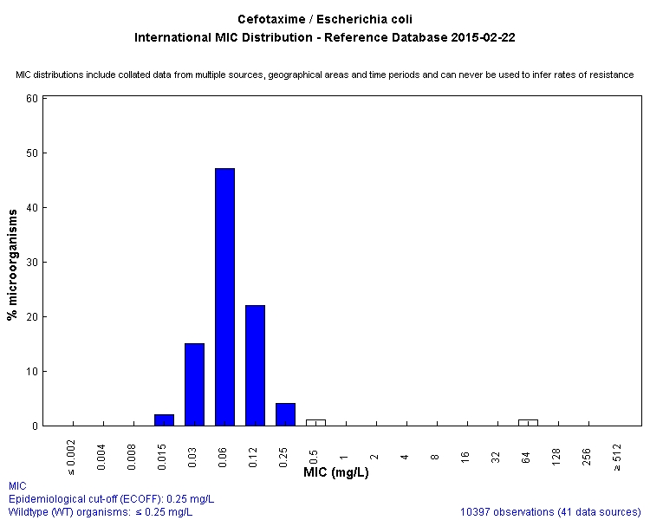
The logical (symmetrical)
ECOFF = 0.25 mg/L

Slide 23
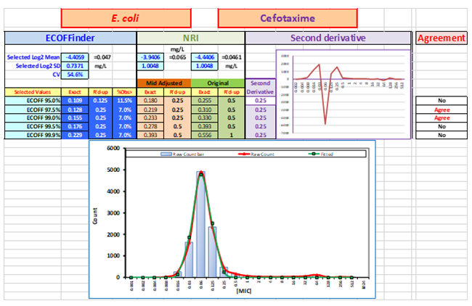
This page is intentionally blurred!

Slide 24
Rules for setting ECOFFs are being developed
Two complementary approaches
5.1.1. A visual estimation based on the inspection of individual and aggregated distributions in the complete dataset. For each distribution the mode is identified and the distribution accepted or discarded. A visual ECOFF capturing 99% of the putative wild type distribution is determined. This is compared with the statistical estimate.
5.1.2 A statistical approach applying available statistical methods. The ECOFF is based on the MIC value which captures 99 % of the modeled wild type distribution.

Slide 25
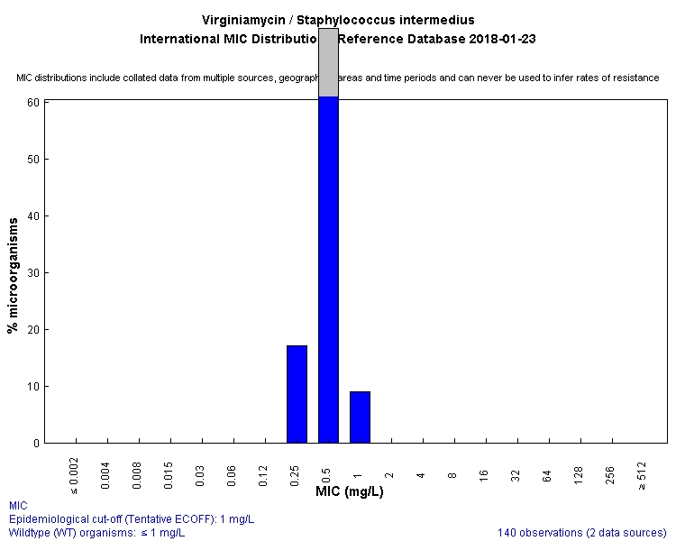
ECOFFs and Tentative ECOFFs
In special cases there is a need to determine tentative ECOFFs.
  There is a need for an ECOFF.
  The data available does not fulfill all criteria needed for an ECOFF.
  The species is difficult to work with or very rare.
  A standardised method has not yet been described.
Tentative ECOFFs will be named TECOFFs and will be reviewed when there is new material or otherwise every 5 years.

Slide 26
In summary
The EUCAST website provides MIC distributions and ECOFFs based on large numbers of MICs and MIC distributions. Access is free of charge.
The ECOFF is the highest MIC for organisms devoid of phenotypically detectable acquired resistance mechanisms.
ECOFFs are used for sensitive phenotypic detection of resistance as a biological phenomenon.
Several statistical methods have been developed for determining ECCOFs on MIC and zone diameter distributions.
A EUCAST subcommittee with >40 international experts have developed rules governing the aggregation of MICs and the setting of ECOFFs.
Tentative ECOFFs may be determined on fewer distributions than ECOFFs.

Slide 27
Slides for discussion only:

Slide 28
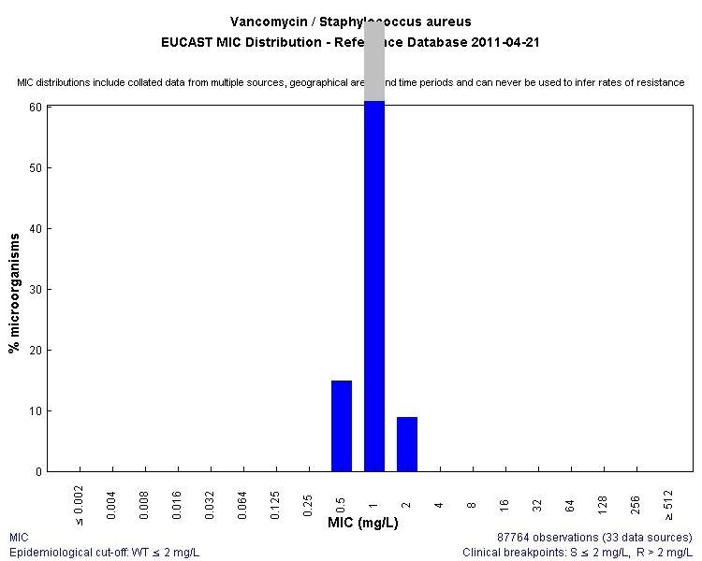
Factors influencing the mode and width of WT distributions
Mode
Width

Slide 29
The mode of the wild type MIC (or zone diameter) distribution:
The inherent activity of the drug on the species
The test system (medium, pH, ions etc) and anything systematically influencing the activity of the agent.
Incubation time – MICs increase with time

Slide 30
The width of the (MIC or zone diameter) distribution
Biological variation among wild type strains in their susceptibility to the agent?
Biological variation among wild type strains in other traits that may influence the MIC
  Variation in any biological characteristic such as generation time, nutrient dependency, atmosphere dependency etc
Random exogenous variation influencing the activity of the drug
  pH, cations, incubation atmosphere and time, etc
Variation in reading (between days, between readers, between systems)
The stability of the molecule
Differences between manufacturers of media and disks
…
Notes:
30

Slide 31
Sundquist, M, Kahlmeter, G. Factors influencing mecillinam susceptibility.
Notes:
31

Slide 32
Copyright
In English: The copyright of all documents, data, presentations and videos published on the EUCAST website remains with EUCAST. All are freely available for re-use if reference to the EUCAST website is given and they are not resold.
Any secondary publication of documents, data, presentations and videos must be referenced with the declaration that "These data have (or this document, presentation or video has) been produced in part under ECDC service contracts and made available by EUCAST at no cost to the user and can be accessed on the EUCAST website www.eucast.org. EUCAST recommendations are frequently updated and the latest versions are available at www.eucast.org."
Thank you

Slide 33
Assessing MIC distributions for aggregation*
*From the EUCAST SOP 10

Slide 34
*From the EUCAST SOP 10

Slide 35
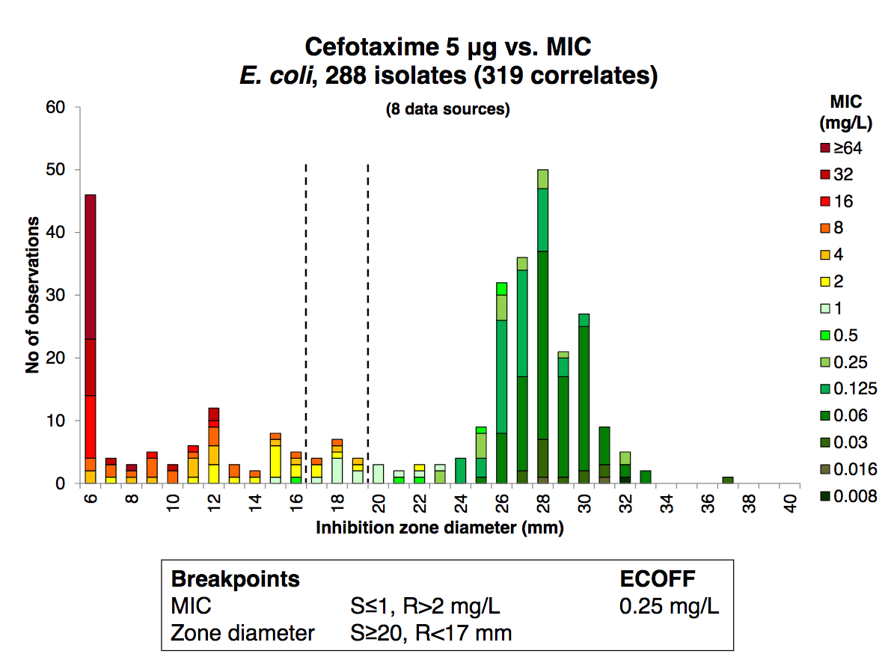

Slide 36
